Slide 1
Project Title: Emotion Detection
Team Members:
Vinay Bojja
Zhimin Meng
Notes:
Hello Everyone, Welcome to our Emotion Detection project. Our team consists of myself Vinay Bojja and Zhimin Meng as the team members.

Slide 2

https://www.pinterest.com/pin/391883605072337705/
Notes:
Most of you might be aware of this iconic scene from Peaky Blinders where Grace asks Thomas Shelby whether he is Happy or Sad?. Instead of asking him the question she could have used CNN or ViT model to predict his emotion. And we can help her compare which model is best for analysing his emotion in further slides.

Slide 3
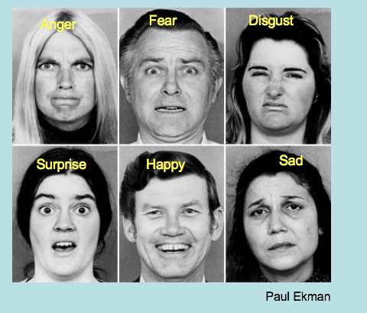
Description
Project AIM: To detect emotions from facial images.
https://quizlet.com/835021750/meh-health-starter-assignment-flash-cards/
Notes:
The project aims to compare different approaches for detecting emotions from facial images. Specifically, I will investigate how various deep learning techniques perform in recognizing different human emotions such as happiness, sadness, anger, surprise, fear, and disgust.

Slide 4


Why We Choose This Project:
https://greenimaging.net/what-is-going-on-with-healthcare/
https://www.groupon.com/deals/jam-s-viritual-quick-fix-2
Healthcare
Marketing
Notes:
The project has applications in various fields such as healthcare, marketing and many more.

Slide 5


https://sdcsalesar.live/product_details/47570861.html
Sentiment Analysis on Social Media
https://acidd.org/
Mental Health Monitoring
Notes:
Understanding human emotions from visual cues can enhance user experience in applications like virtual assistants, sentiment analysis in social media, and mental health monitoring.

Slide 6

Background
Previous Approaches to Emotion Detection:
Traditional machine learning techniques like SVMs, decision trees, and ensemble methods have been used for emotion detection.
These approaches struggled to capture the complexity of facial expressions and nuanced emotional states.
In later stages of development, deep learning techniques, particularly Convolutional Neural Networks (CNNs), have revolutionized image classification tasks.
https://www.rebellionresearch.com/what-are-graph-based-neural-networks
Notes:
Previous approaches in emotion detection has primarily focused on utilizing traditional machine learning techniques such as support vector machines (SVMs), decision trees, and ensemble methods. While these approaches have shown some success, they often struggle to capture complex patterns present in facial expressions. In recent years, deep learning techniques, particularly Convolutional Neural Networks (CNNs), have emerged as powerful tools for image classification tasks, including emotion recognition. CNNs have demonstrated the ability to automatically learn relevant features from raw pixel data, making them well-suited for tasks involving visual information.

Slide 7
Previous research
The survey emphasizes the importance of reliable datasets for training and validating FER models. That‘s important for subsequent work
A key finding from the analysis showed a marginally better precision for classical approaches compared to their neural network counterparts.But neural network-based approaches, providing a deep dive into the state-of-the-art techniques used in the domain .
Neural networks, especially deep learning models like convolutional neural networks (CNNs), tend to perform better as the size and variety of the dataset increase.
Notes:
The survey emphasizes the importance of reliable datasets for training and validating FER models. highlight their importance for advancing future research. From our findings, we observed that traditional methods always outperformed deep learning in terms of precision. However, it's essential to note that deep learning models like Convolutional Neural Networks (CNNs) or via, tend to excel as the dataset's size and diversity grow. This key insight pushes the field of FER towards enhancing data collection and processing methods to fully tap into the capabilities of neural network frameworks.

Slide 8

Data Source
Link: https://www.kaggle.com/datasets/ananthu017/emotion-detection-fer/data
https://www.kaggle.com/
Notes:
We obtained the data from kaggle.

Slide 9
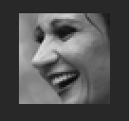
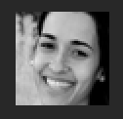

Dataset Details:
Total examples: 35,685
Images are classified according to the emotional expressions depicted in the facial features, including happiness, neutrality, sadness, anger, surprise, disgust, and fear.
Image size: 48x48 pixels
Images are in grayscale.
Notes:
Now, let's delve into the dataset. It contains a total of 35,685 images, including both training and testing data.
The images are organized into folders based on different emotions like happiness, neutrality, sadness, anger, surprise, disgust, and fear.
Each image is sized at 48 x 48 pixels and is in grayscale.

Slide 10
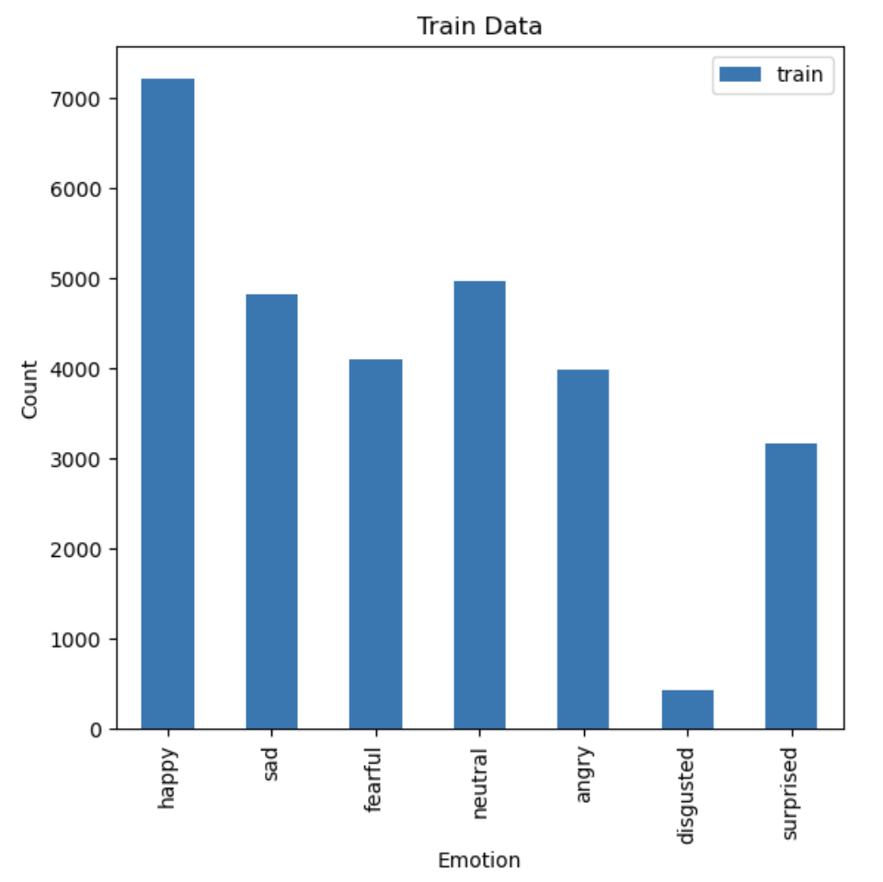
Train Dataset
Total images: 28,709
Classes:
'happy': 7215
'sad': 4830
'fearful': 4097
'neutral': 4965
'angry': 3995
'disgusted': 436
'surprised': 3171
Notes:
In the training dataset, there are 28,709 images. Among these, there are 7,215 images portraying happiness, 4,830 images depicting sadness, 4,097 images representing fear, and so forth, as illustrated on the slide.

Slide 11
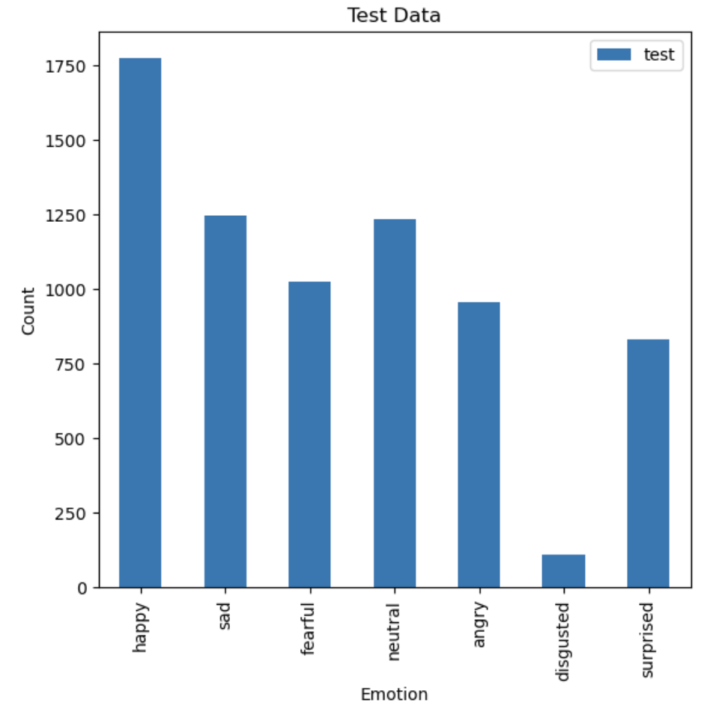
Test Dataset
Total Images: 7178
Classes:
'happy': 1774
'sad': 1247
'fearful': 1024
'neutral': 1233
'angry': 958
'disgusted': 111
'surprised': 831
Notes:
In the test dataset, there are 7,178 images. Among these, 1,774 images show happiness, 1,247 images show sadness, 1,024 images show fear, and so on, as depicted in the graph.

Slide 12
Utilized "rizvandwiki/gender-classification" pre-trained model deployed on Hugging Face to categorize images as male or female. The statistics are below.
 | Male(Train) | Female(Train) | Male(Test) | Female(Test)
Happy | 3270 | 3945 | 835 | 939
Sad | 2530 | 2300 | 666 | 581
Fearful | 2071 | 2026 | 499 | 525
Neutral | 3007 | 1958 | 743 | 490
Angry | 2818 | 1177 | 662 | 296
Disgusted | 246 | 190 | 77 | 34
Surprised | 1576 | 1595 | 446 | 385
Notes:
To classify images into male and female categories, we employed a pre-trained model from Hugging Face, the name of which is displayed on the slide. Using this model, we determined the number of males and females in both the training and testing datasets. You can find these counts in the table provided above.

Slide 13
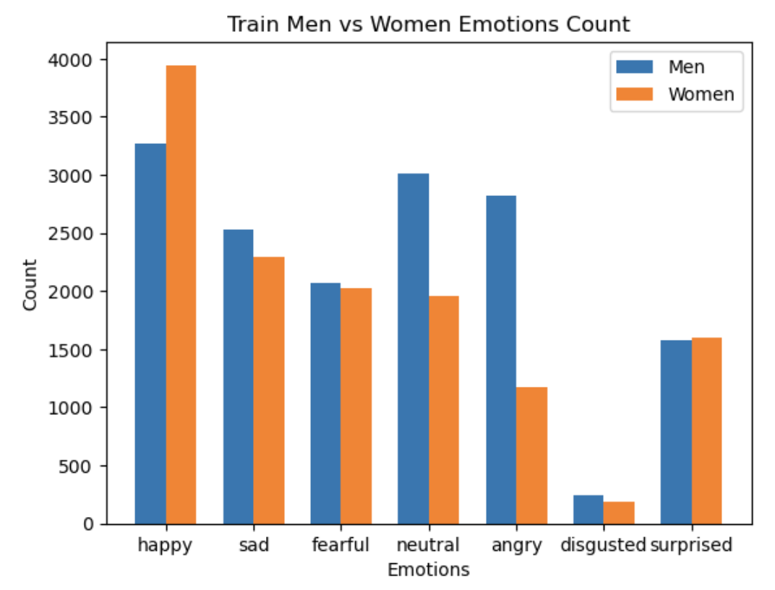
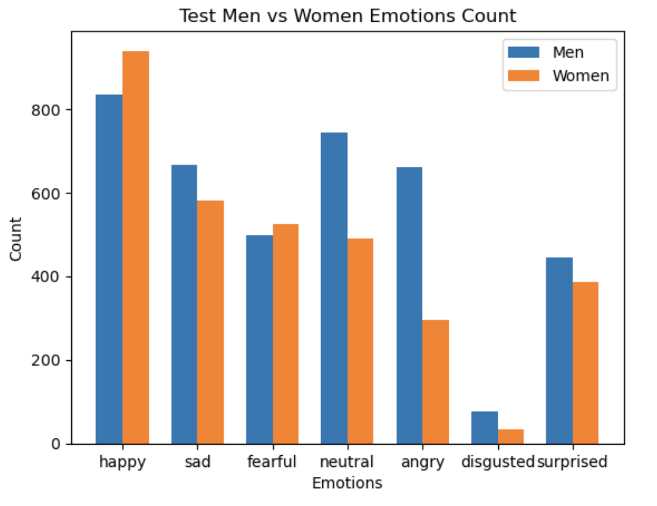
Notes:
This slide displays a graph showing the number of males and females in the dataset. In the training dataset, there are approximately 3,000 to 3,500 happy men, while the count of happy females is close to 4,000 and so on.

Slide 14
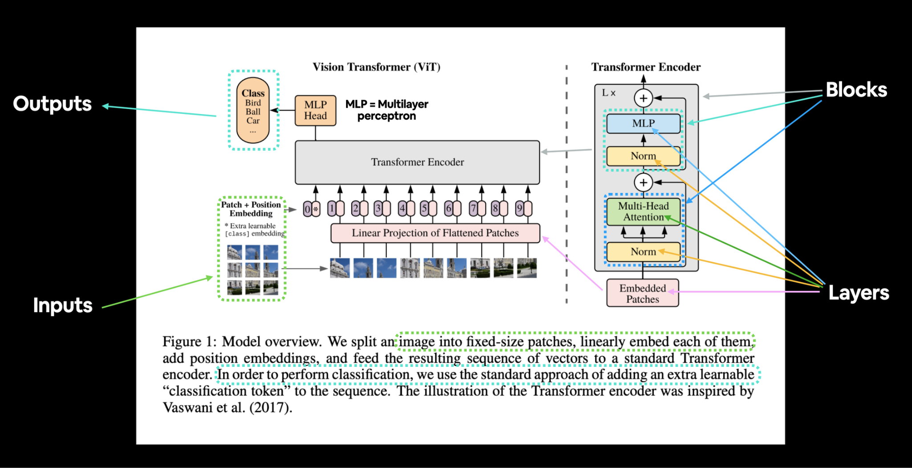
Vision Transformers
https://www.linkedin.com/pulse/mastering-image-classification-vision-transformers-vit-ayoub-kirouane/
Notes:
The first step in a ViT model is to split the image into multiple fixed-size patches. Imagine dividing a picture into a grid of smaller, equally-sized squares.
Each of these patches is then flattened and transformed into a data format that the model can process, known as embedding. This step is similar to converting words into vectors in natural language processing.
Then ViT adds positional information to each patch, helping the model understand where each piece originally fits in the image.
Transformer Encoder: These embedded patches, now with positional encodings, are fed into a transformer. The transformer uses mechanisms like self-attention to weigh the importance of one patch in relation to others, enabling it to learn complex relationships between different parts of the image.
Finally, the output from the transformer is passed through layers that act as a classifier, determining what object or feature the image represents.

Slide 15
Several options
Timm
EfficientNet
MobileNets
ShuffleNets
MobileVIT
Notes:
Timm(short for PyTorch Image Models)
EfficientNet scales up simplified CNNs in a more structured way using a compound coefficient to scale depth, width, and resolution uniformly.
MobileNets use depthwise separable convolutions to reduce the number of parameters and the computational cost.
ShuffleNets utilize pointwise group convolutions and channel shuffle operations to further reduce computational requirements while maintaining a reasonable level of accuracy.
MobileVIT combines the architecture of Vision Transformers with the principles of MobileNets to create a lightweight, efficient model suited for mobile devices.

Slide 16
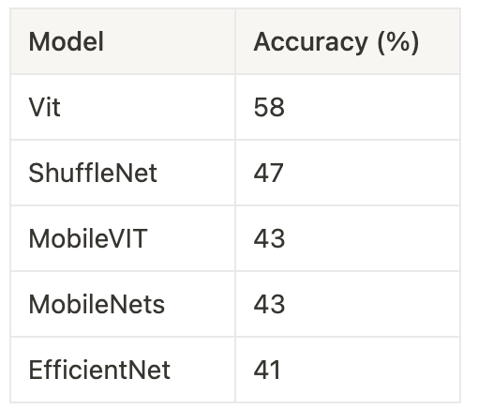

Analysis using ViT and other related models.
TrainData: 7*200 images TestDate:100%

Slide 17
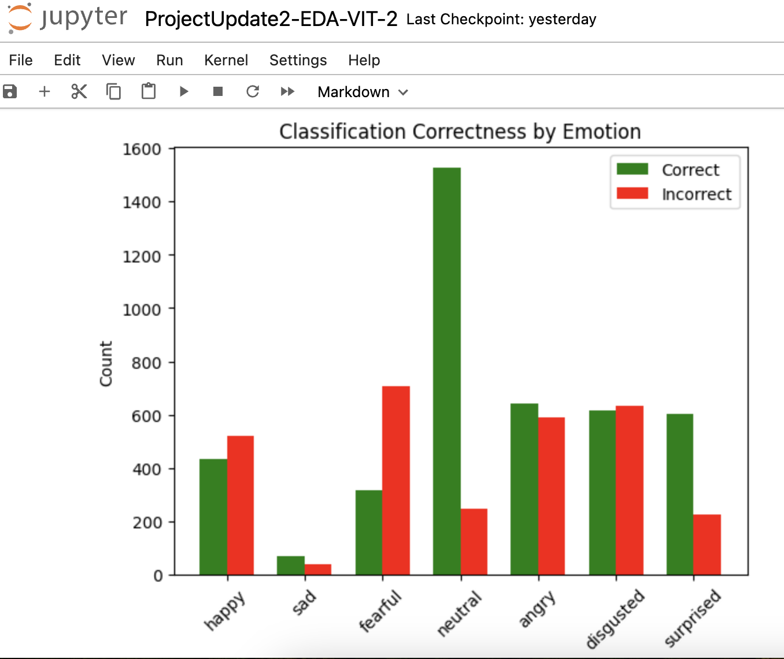
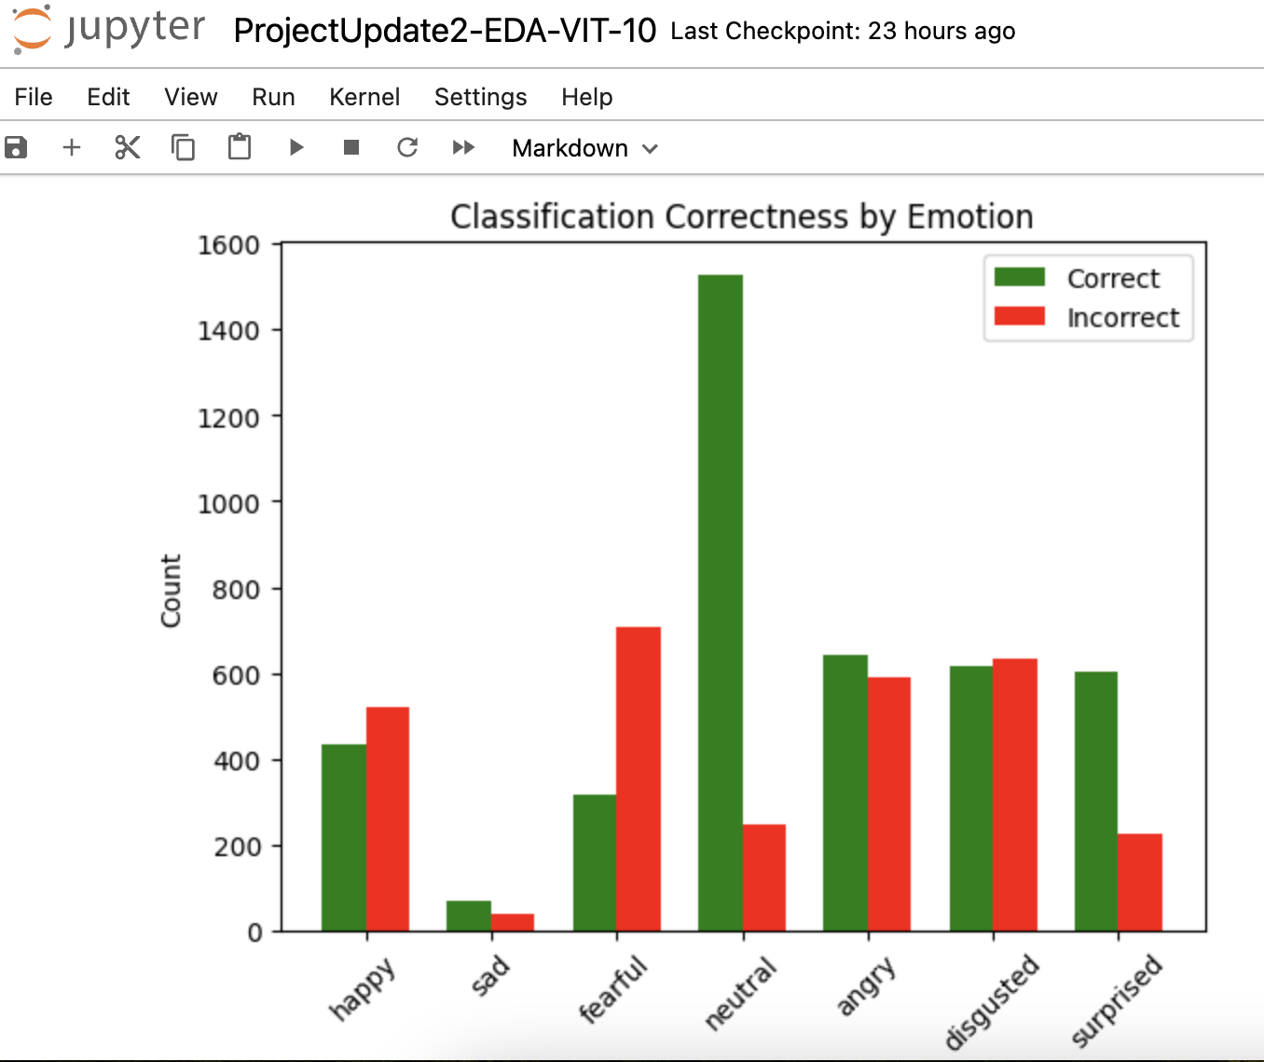
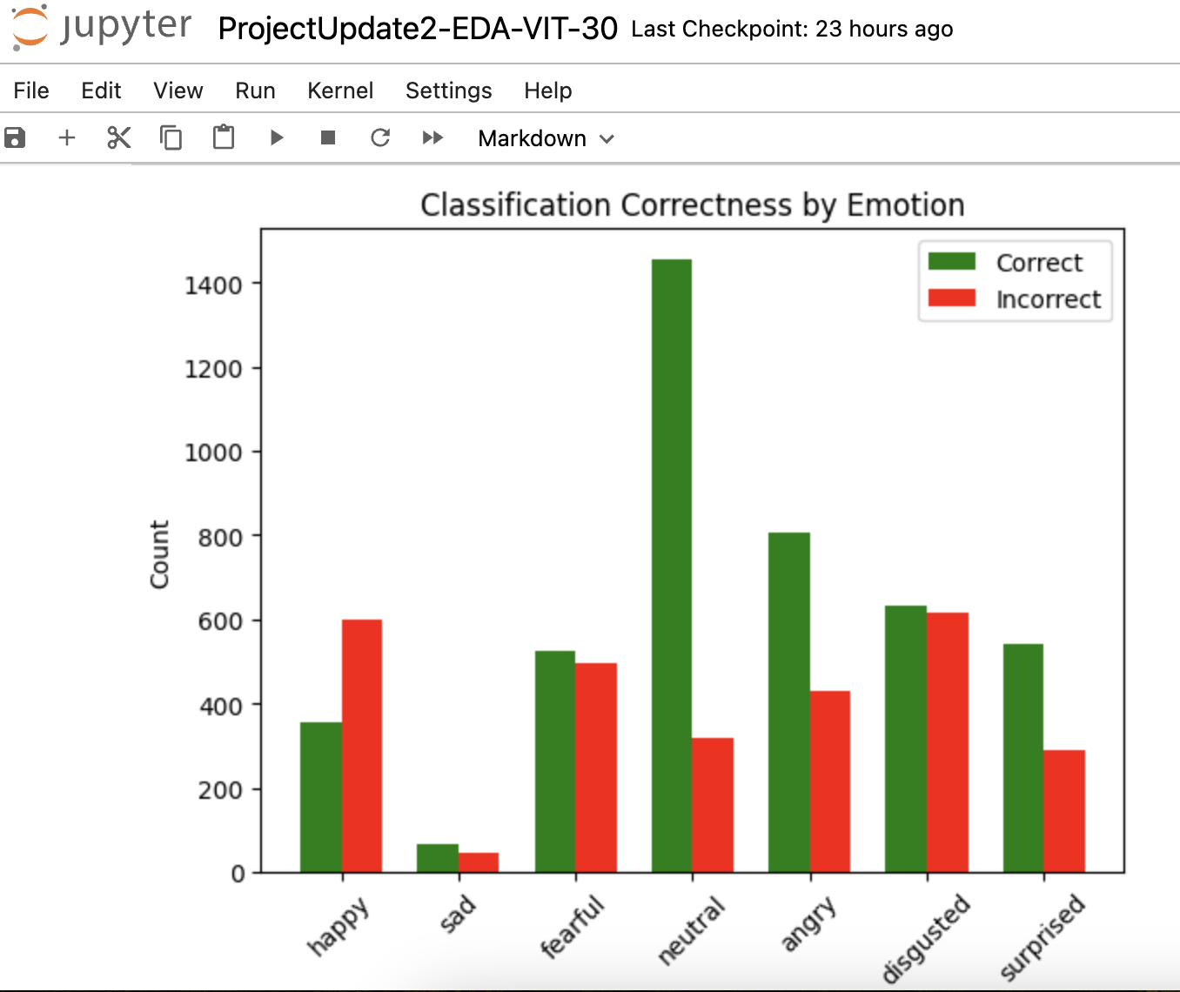
Performance of different data sizes
TrainData: 30%
TestDate:100%
Vit accuracy: 61%
Notes:
Now let me give control of slides to vinay.

Slide 18
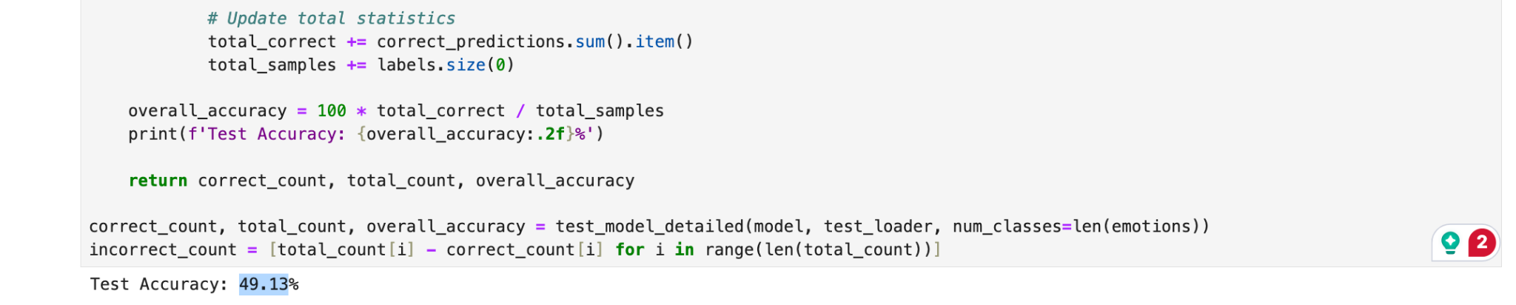
Analysis using Convolutional Neural Network.
TrainData: 30%
TestDate:100%
CNN accuracy: 49.13%
Notes:
Same as Zhimin mentioned earlier, we used 30% of the data for training and 100% for testing. Upon testing the CNN model on the test data, we got 49.13% accuracy

Slide 19
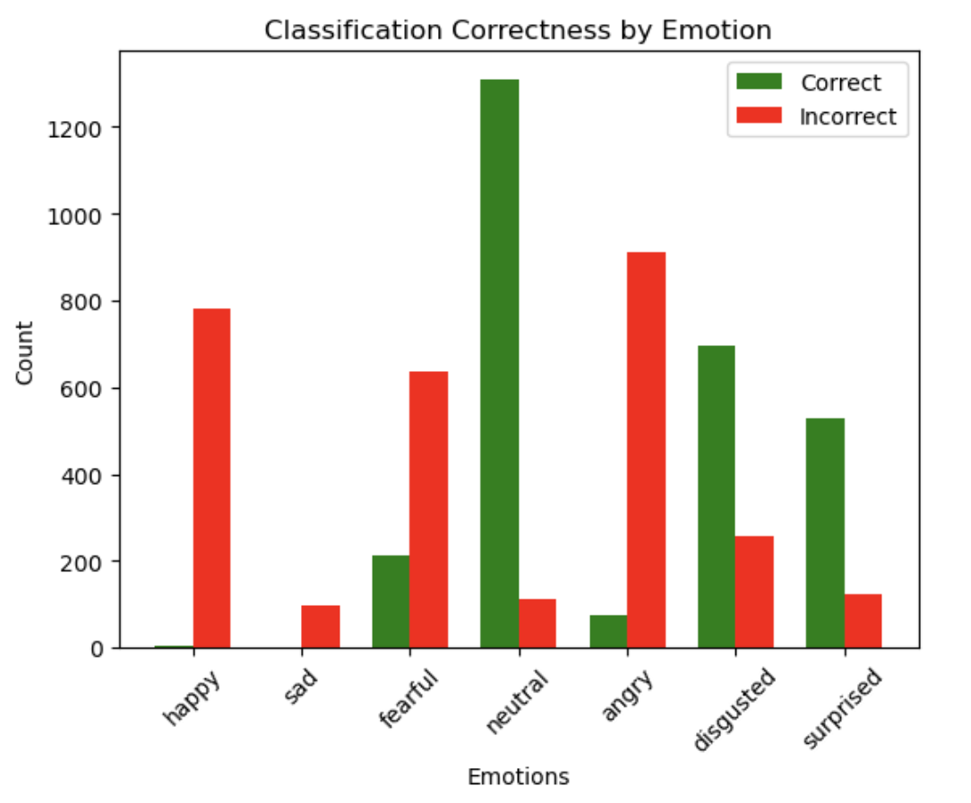
Notes:
The graph in the slide represents the correctness of emotions predicted by the CNN model. As we can see, most of the predictions are correct for neutral emotion. Whereas for happy and sad emotions, we can say that almost all the predictions are incorrect.

Slide 20
Comparison
Convolutional Neural Networks
Vision Transformers
- Well-suited for tasks where local features are critical.
- Ideal when computational resources are limited.
- Potential scalability issues with very large datasets or high-resolution images.
- Excel in capturing global relationships in images.
- Demanding computational requirements for training, potentially limiting scalability.
- ViTs are more scalable as they process images in a tokenized format
Notes:
Cnns are weel suited for tasks where local features are critical whereas ViT excels in capturing global relationships in images. Cnns are ideal when computational resources are limited whereas ViT demands computational requirements for training. Cnns have potential scalability issues with large dataset whereas ViT are more scalable as they process images in a tokenized format. To conclude, we will recommend grace to use CNN if she has low quality image. And If she has high quality image then, then we would recommend using ViT.

Slide 21
Thank you

